Slide 1
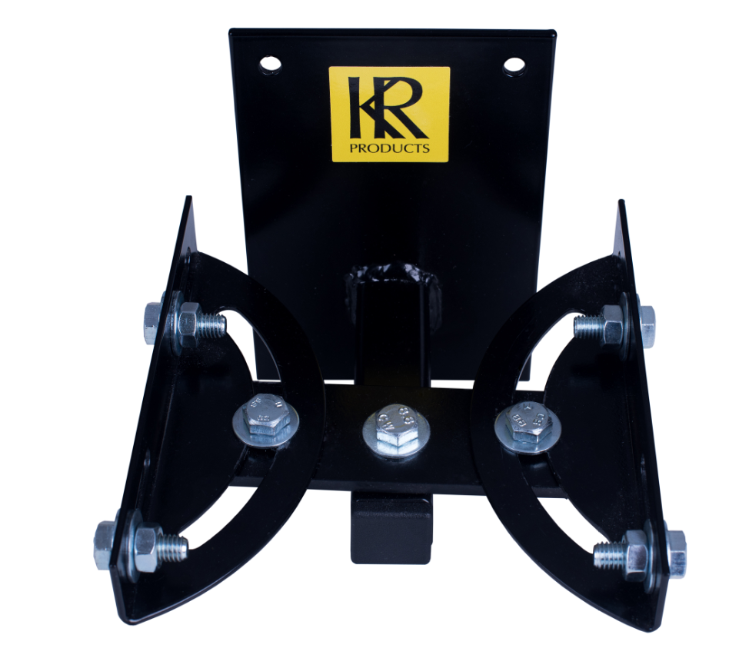
100mm
200mm
100mm
Slots 40mm
155mm

